Slide 1
A Usability Assessment of EBSCO Discovery Service
David Comeaux – Web Development Librarian
Emily Frank – Instructional Technologies Librarian
Mike Waugh – Systems Librarian

Slide 2
EDS at LSU
LOUIS acquired for consortium January 2012
LSU Libraries worked with EBSCO to add holdings, databases, e-acquisitions not provided by LOUIS
Fall 2012: Fine-tuning, ongoing soft rollout
Need for assessment
  Usage (practice and ability)
  Barriers to use
  Recommendations for improvement
Notes:
Ongoing questions about the level of buy-in from librarians
First step in an assessment process

Slide 3
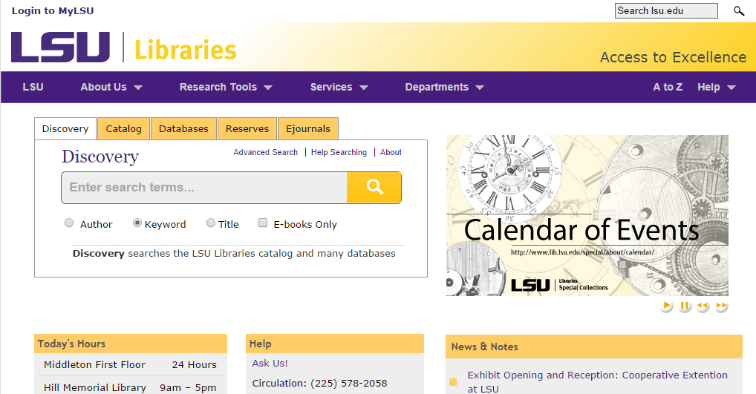
EDS at LSU

Slide 4
Staff Survey
25-question survey sent to all Libraries staff
  133 FTE staff (professional, support, students) at LSU Libraries (Middleton and Hill)
April 14-24, 2014
Delivered via email using Qualtrics
49 responses

Slide 5
Staff Survey
31 respondents work a public service desk:
  18 use Discovery with users (58%)
  13 do not (42%)
19 respondents teach library instruction:
  13 teach Discovery (68%)
  6 do not (32%)
41 respondents perform work-required research:
  24 use Discovery (59%)
  17 do not (41%)

Slide 6
Staff Survey
For those who use it at a public service desk:
  Good starting point for research (13 or 72%)
  Single point of entry to Libraries’ content (13)
  Prominent location on Libraries’ homepage (12 or 66%)
  Full-text resources in results (11 or 61%)
  Searches multiple formats (11)
  Satisfies needs and preferences of users (10 or 55%)
For those who do not use at a public service desk:
  Preference for other available tools (10 or 77%)
  Issues with relevancy ranking (7 or 54%)
  Overwhelming number of results (6 or 46%)
  Difficult to find books (6)
Notes:
Responses were common in other assessed areas: instruction and

Slide 7
Staff Survey
Use at a public service desk:
  Slightly more common when working with undergraduates:
    Undergraduates: 16/18 respondents use Discovery “sometimes,” “often,” or “all of the time”
    Graduates: 14
    Faculty: 13
Use when teaching library instruction:
  Commonly taught in undergrad and graduate liaison-specific instruction

Slide 8
Staff Survey
Overall rates of satisfaction with Discovery:

Slide 9
Staff Survey
How could we make Discovery a more useful tool? (24 responses)
  Simplify ability to find print books (4)
  Add more databases (4)
  No ability to improve a bad tool (4)
  Relevancy ranking (4)
  Find@LSU link resolver (2)
  Better librarian education
  Improve marketing
  Make limiters more visible
  Better searching for specific journal titles
  Not designed for doing searches of Special Collections materials
Notes:
Relevancy ranking issues: : Ebooks to the top, base future searches on results from previous searches, choice of ranking algorithm)
Better librarian education: (e.g. I don’t know exactly which databases in my field are included in the search, improve librarian buy-in)

Slide 10
User Survey
1) In general, do you find what you're looking for in Discovery?
  Always
  Often
  Rarely
  Never
2) How easy or difficult is Discovery to use?
  Easy
  Moderate
  Difficult
3) How can Discovery be improved?
4) Please select your status:
  Undergraduate student
  Graduate student
  Faculty
  Other
Notes:
User ran EDS search and arrived at the results page
4 question survey as a pop-up light box

Slide 11
User Survey Dialog in EDS
Survey placard came from javascript code in EDS wiki
  “Survey dialog with display delay and cookies”
Options to make it so that it won’t pop up multiple times for same user
Tested in test profile
Customized the look and feel
Submitted for review by Web Committee
Notes:
The code came from the EDS wiki. The widget was called “Survey dialog with display delay and cookies”. I tested it in the Test profile. Added it to the bottom branding.
Web committee didn’t like the delay. Made it pop up more immediately.

Slide 12
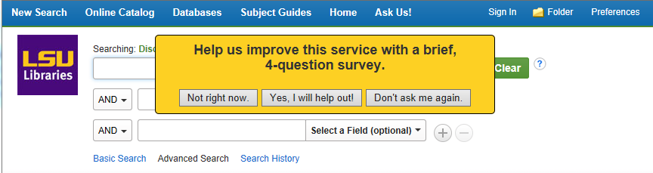
Notes:
Three buttons. Yes will bring them to the survey offsite. The not right now will make the dialog disappear, but it may reappear on another day. The Don’t ask me again stores a cookie to make the dialog disappear

Slide 13
User Survey
Ran 10:45 AM April 21 - 3:30 PM May 1
Number of EDS sessions during survey: 10,801
Full-time enrollment for Spring 2014:
  Undergrads: 20,609
  Grads: 3,112
Response:
Notes:
Web Advisory Committee goal: Goal response rate: minimum of 100 participants over the course of 1 to 2 weeks

Slide 14
User Survey
In general, do you find what you’re looking for in Discovery?

Slide 15
User Survey
How easy or difficult is Discovery to use?

Slide 16
User Survey
How can Discovery be improved?

Slide 17
From Survey to Action Items

Slide 18
Actions: Link of Confusion
Confusion about our LinkSource settings
  Initially it was set to show up for everything, whether we had full-text or not
  Changed to show up only for full-text items
Added a link to the ILL form
  Set to show up for abstracts, or any non-full-text
Notes:
Initially LinkSource was set up to show up for all items that did not serve up another link.
For one we were using it to serve up an ILL form, but the other part was that I thought of it as a safety net for serving up possible links. I was confused about its function, because when set up to show for full-text, it seemed to show up a lot for things that we didn’t have access to. Come to find out, this was almost always due to a specific metadata problem, that needed to be corrected on a case by case basis.
Changed it to only show up for full text.
Created a customlink to ILL form.

Slide 19
Actions: Physical Book Search
Both surveys identified need for physical book search
Change cataloging of records post-export?
  Kludgy fix that would not completely work
Enhancement coming in EDS that would allow this
In the meantime, using the physical location as a limiter
Notes:
Discovery service follows the letter of the cataloging law, that ebooks are a subset of books, and thus while you can identify ebooks, you cannot define those things which are not ebooks but are books. That is, while you can search on it, there is not a built in limiter/facet for it.
Already thought that this would be a problem, but having the survey answers really gave me the feeling that there was a mandate to fix this problem.
Pursued though of making changes to marc records post-export, but it wouldn’t quite work the way we wanted.
Future enhancement coming in EDS.
Many libraries already make Electronic Resources as a Location. We made a change to do something similar, so that searching a library would exclude these ebooks.

Slide 20
Actions: Future actions
GUI problems
  SmartSearch pop-up obscures the search box in IE
  Discipline search could be moved to bottom of the page
  EDS development requests
Provide helps at point of need
  Links for feedback forms and librarian intervention
For future: Use API for results display
  More control
  To leverage future usability assessments

Slide 21
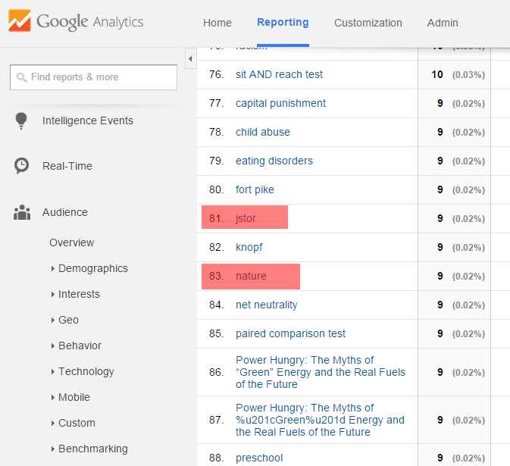
Notes:
The list of search terms in used when searching EDS, for a one month period, with terms ranked by frequency.
Here are particular journal or databases highlighted: JSTOR and Nature.
I though there might be some full citations or abstracts, but didn’t run across too many of them.

Slide 22
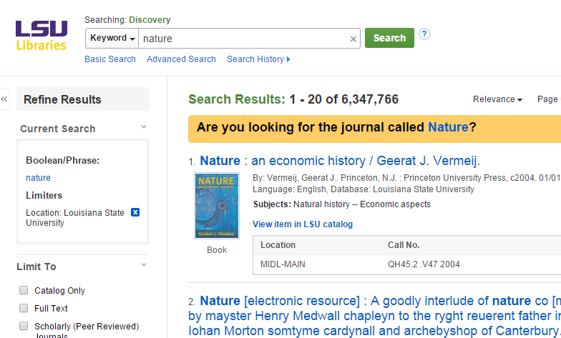
Notes:
Example of a targeted query placard, where a search for “nature” asks if one is searching for the journal called Nature.

Slide 23

Notes:
Samples of some of the targeted query placards.

Slide 24
Search queries: Future actions
Citations and abstracts as search terms?
Subject group analysis

Slide 25
From Survey to User Testing

Slide 26
Analyze open-ended comments
Open-ended comments provide insights into patron perceptions that can be starting points for further research
Our first step was to look at the comments and divide them into major categories

Slide 27
Analyze open-ended comments
Most could be grouped into the following categories:
  Search Functionality/ Search Results (34)
  User Interface (24)
  Accessing Full Text (14)
A significant number clustered on these themes
  Content (11)
  Help (9)
  Fine like it is (8)
  Suggested search (5)
Notes:
Many of these don’t require further research. Mike has already described how we have changed the system to only show full text when it is available. Also content

Slide 28
Analyze open-ended comments
Regarding the search functionality and results issues, it’s helpful to break these down further
The main themes emerging are:
  Search functionality / UI improvements (15)
  Suggested improvements in results display (13)
  Poor match between search terms and results (7)
Notes:
So in further analysis of the comments, I found that 15 suggestions were related to both UI suggestions and functionality – they are inseparable. There were a lot of comments about improving search results. And finally there were a fair number of comments that questioned the relevancy of search results.

Slide 29
What to eliminate
Relevancy of search results -
  There are limits to what we have control over
  The changes we can make don’t require users to verify the improvements
Notes:
There are two good reasons not to build relevancy questions into a user test. One reason is that we don’t have a lot of control over the relevancy. Second, there’s no need for patrons to verify an improvement in this area; this is something we librarians can do ourselves. (Example; if a title search shows the matching item 20th in the list, and we make a change to bring it to first, that is sufficient)

Slide 30
What to minimize
Display of search results -
  Again, there are limits to what we have control over
  Focus on what we can change for know
  Do exploratory research for later

Slide 31
What suggestions to focus on
Improvements to search interface
  Can be made relatively easily
  Need to test with users to verify

Slide 32
What suggestions to focus on
Improvements to search interface
  All these comments suggest making a pre-select limiter for books and other items:
    Additional filters
    Would like book only default; customization of defaults if logged in
    Have different sections for physical books available and ebook
    Give options for result medium so we get only books if we're looking for books, etc.

Slide 33
What suggestions to focus on
Improvements to search interface
  Design a search interface that includes pre-filter for articles and books
  Create scenarios with information needs
    You’re writing a paper on gay marriage, and your professor said you need to find at least three scholarly articles and five popular magazine articles…
    You have to write a final paper on the topic of your choice. The assignment requires at least three books…
  Record and observe whether patrons use this feature, and measure their success

Slide 34
Testing method
Combining usability testing with interviews
  Usability testing – we will design a test scenario using a modified search interface and observe patron interactions
  Interviews – after the usability testing, we will ask questions designed to shed light on areas we’re not clear on

Slide 35
Your Experience – “Anecdata”
Does your library use EDS?
What do your librarians and users say about it?
Have you assessed it?
Have you done usability testing?
Do you plan to do usability testing?

